Slide 1
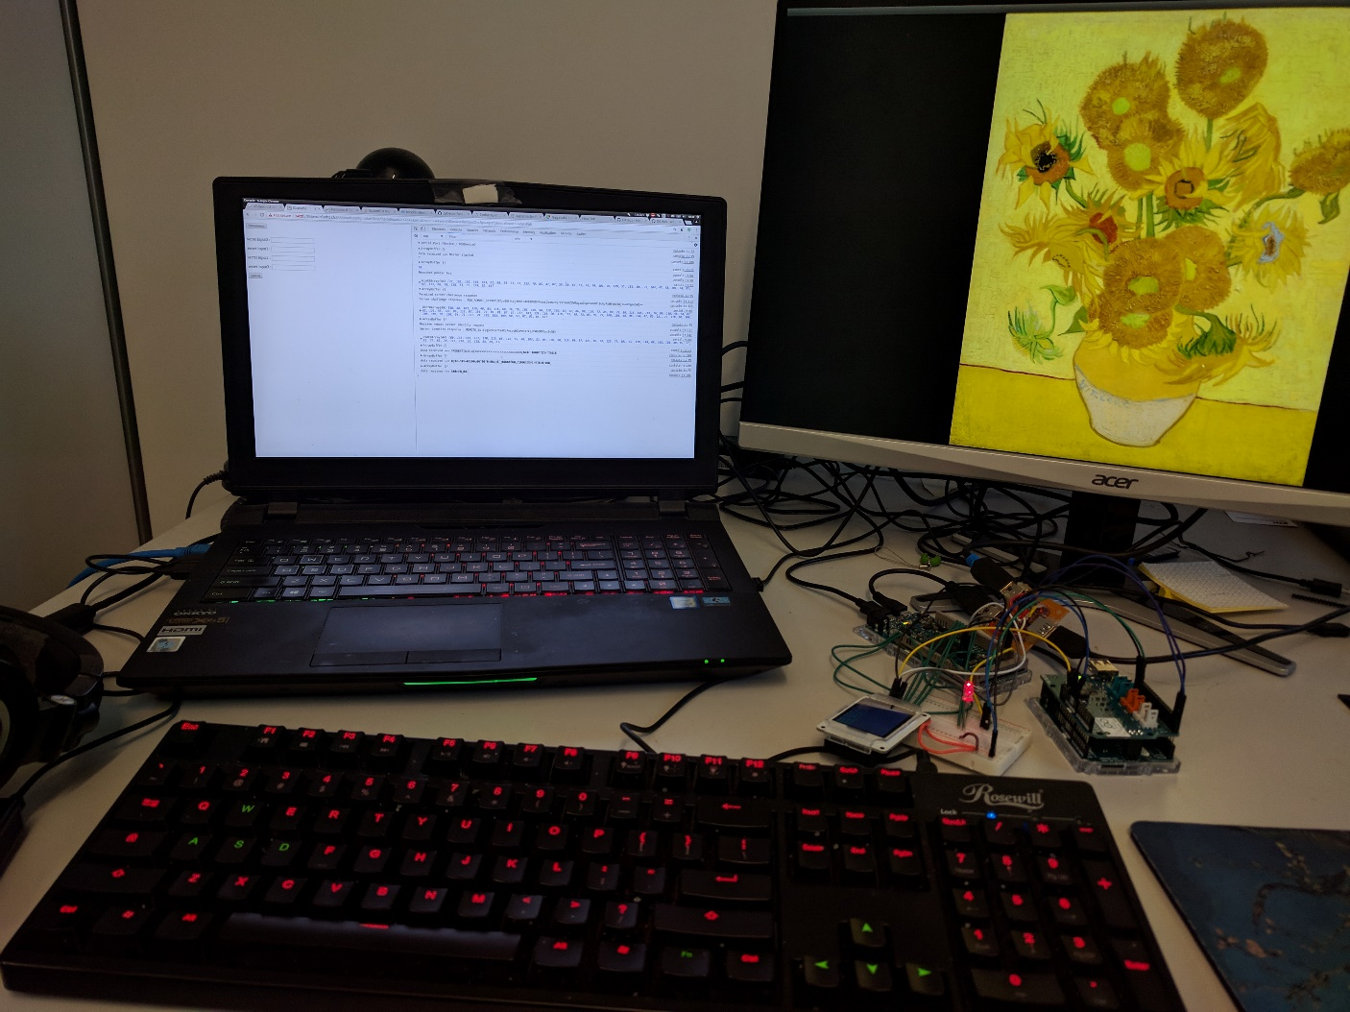

Slide 2
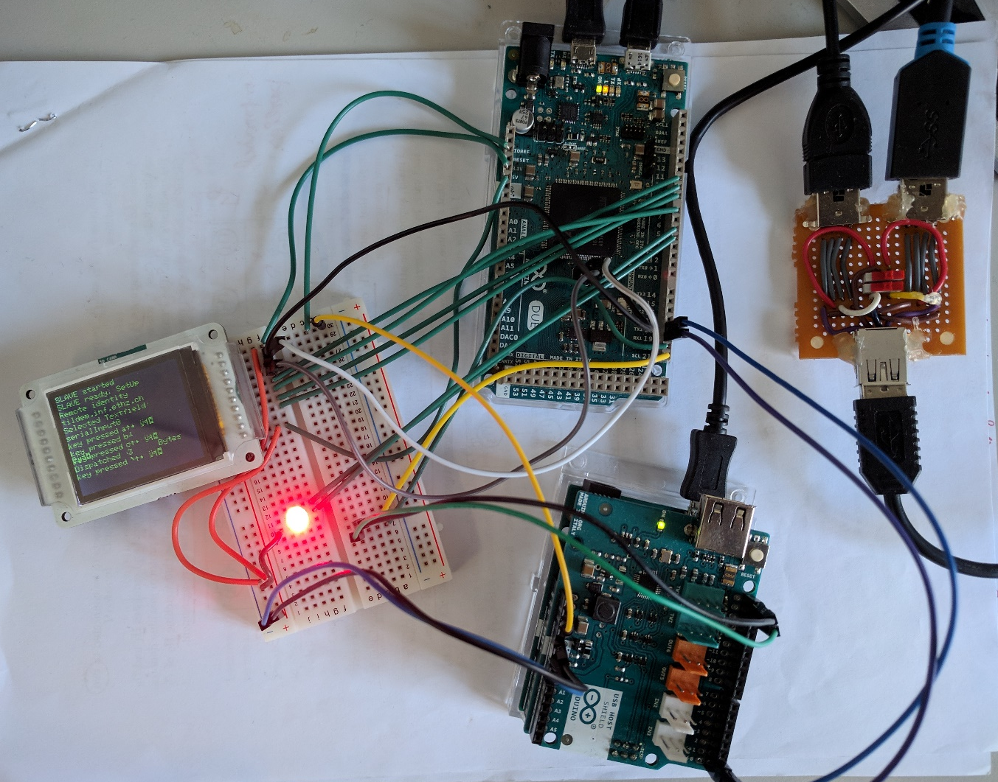
Arduino Due
USB switch
1a
4
1a
Display Unit
2
4
2
3
3
1b
LED Indicator
1b
Arduino Leonardo

Slide 3
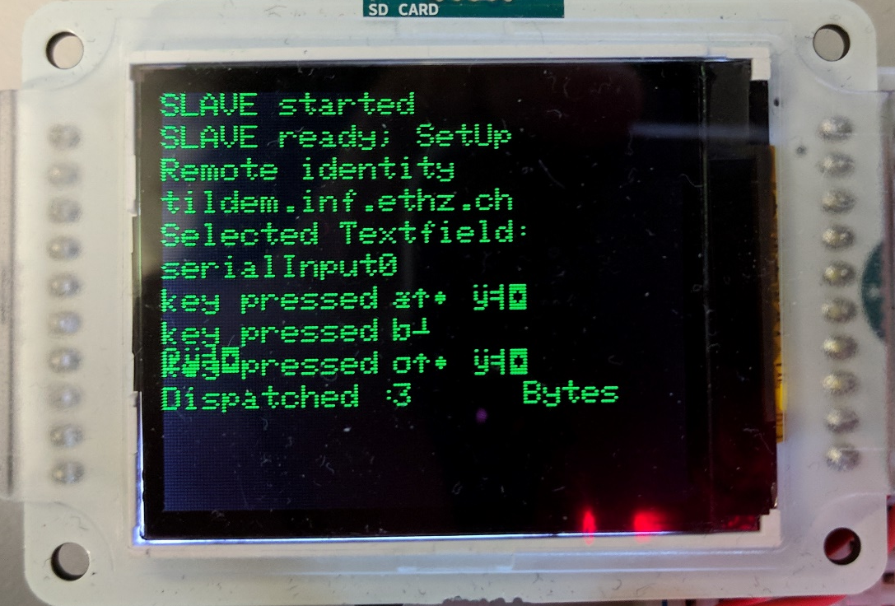
1
Certificate
2
Input textfield id
3
Key stroke

Slide 4
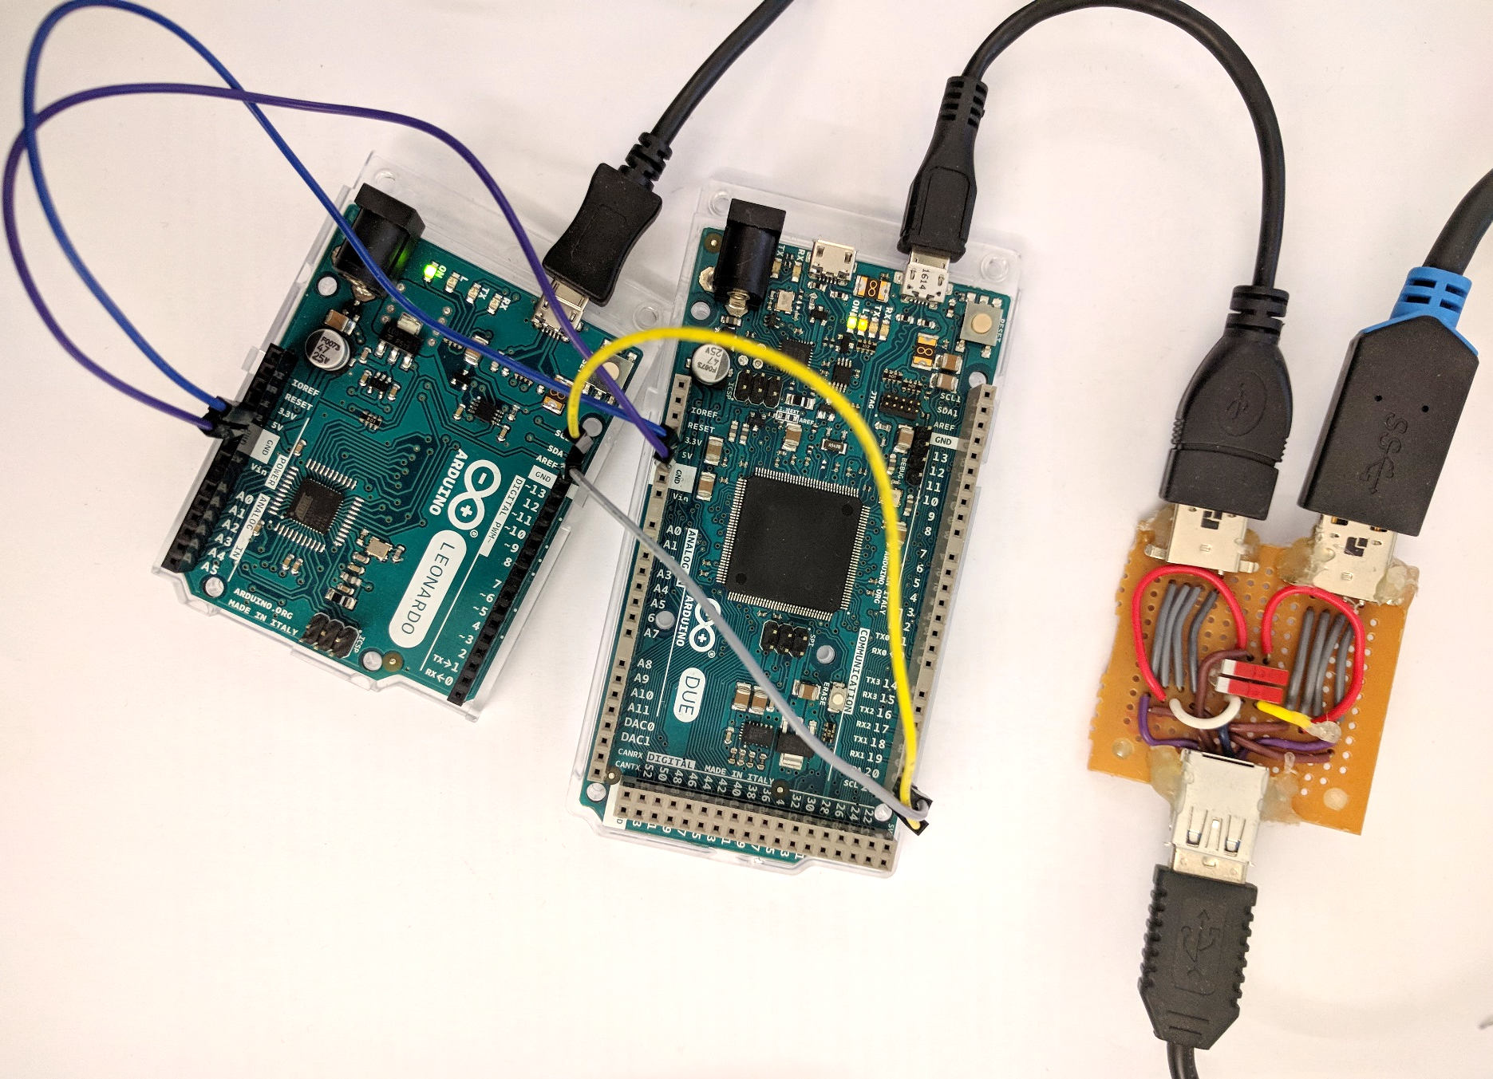
Host system
Pass-through to Host system
5
3
1
7
2
Arduino Leonardo
4
Arduino Due
6
USB switch
Keyboard

